Slide 1
S-Online Examination system with AI
By Team Viper

Slide 2
Team Viper
Mayur Kidi
Dipen Vasoya
Avani Trivedi
Saurabh Singh
Atik Mandhat
Parth Vaghasiya

Slide 3
Problem of current exam system
It is very time consuming.
There are chances of paper leakages in current examination system.
There are more invigilators are required for these exams.
Result processing takes more times cause it is done manually.
It is costly for organizations like they have to manage papers as well as supervisors for exams.
They have to manage good numbers of examination centres as well.

Slide 4
Proposed solution by us
Online exam where students can give their exams from any corner of the world under the supervision of AI.
Automated system that detect the undesired activities of students.
System can generate the question paper with grouping all questions received by the faculties as desired format that can be managed by admin.
It will be time saver and more flexible then current system.
As well as it will be more secure than current system.
There will be automatic grading system that can save lots of time

Slide 5
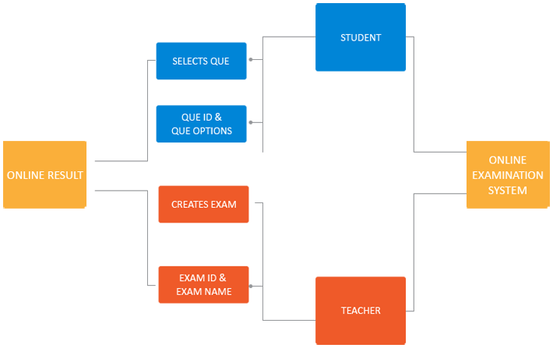
Quick look of our idea

Slide 6
Technologies that can be used.
Python
Scikit-learn
Numpy
Pandas

